Slide 1
Soaring through the Clouds – The Sequel
EMEA PaaS Partner Forum
Budapest, March 2018
Sven, Jose, Lonneke, Luis, Guido, Lucas

Slide 2
The Shop and its Departments (microservices)
Shop
Lucas
Guido
Luis
Lonneke
Jose
Product Catalog
including
Pricing & Discounts
Order
Customers
Loyalty Program
Lucas
Sven
Logistics (Warehouse, Stock, Shipping)
Billing, Invoicing & Collection

Slide 3
Storyline
Shop can be
on line, multi-channel: web, mobile, chat
offline – bricks & mortars store ??
Consumer can
Sign up
Search products
Optional: Get recommendations (based on past orders & current basket contents)
Manage shopping basket
Inspect order total (price) for items in basket (after product discounts and loyalty deduction has been calculated)
Sign up for loyalty program
Place an order
Inspect order status
Check invoices (and underlying billing details) and payment status

Slide 4
The User Interfaces
Menu & Nav
Marketing content
Web (& App?) Shop – Customer User Interface
Sign Up
Sign In
Edit Profile
Sign up for loyalty program
Check on loyalty status / points
Browse/ Search Products
Inspect Details
Rate / Review
Get recommendations
Shopping basket
Inspect the bill
Place Order
Check Order Status /History
Check payment status
Inspect invoices & billing statement
Manage product details
Set prices & discounts
Manage Customers
Manage Loyalty Status
Payment Collection
Invoice mgt
Back Office User Interface
Manage Orders
Management Dashboard
New Orders (size, destination, ..)
Popular products
Order (shipping) Status
Payment status
Manage Stock
Manage Shipping

Slide 5
Considerations
Out of stock orders cannot be ordered (should not be shown at all)
Products can be withdrawn (legal, safety, …)
Customers with (too high) outstanding payments cannot place orders
Loyalty program has three levels – depending on past order total (and manual setting by shop management); each level has different discount rewards
Optional: Orders can be cancelled if they have not yet shipped; if payment has been made, it is turned into a “credit”
Optional: certain products cannot be shipped to certain countries
Currently no customer service, no complaint handling, no reverse logistics (returning orders) etc.

Slide 6
Events
Product Out of Stock
Product Back in Stock (or: Product Stock Status Changed)
Product (catalog) details changed
Product withdrawn (can no longer be offered)
Customer ‘frozen’ (because of outstanding debt)
Customer ‘unfrozen’
New Order
Order has shipped
Payment has been received
New Customer
Customer details have changed
Customer Loyalty Status has changed

Slide 7
Events and Producers
Shop visit
Abandoned basket
Failed search
Product Withdrawn
Product Added
Product Details Changed
Shop
Product Catalog
including
Pricing & Discounts
Event Bus
Order Payment Received
Customer Frozen
Customer Unfrozen
Topic X
Topic Y
Topic Z
Topic Q
New Customer
Customer Changed
Billing, Invoicing & Collection
Customers
Customer Loyalty Status Change
New Order
Order Cancelled
Product Out Stock
Product In Stock
Order Shipping Status
Loyalty Program
Order
Logistics (Warehouse, Stock, Shipping)

Slide 8
Routing Slip based Choreography
Shop
Order
Validate proposed order (synchronously) with Customer | Logistics | …
Initiate PlaceOrder Workflow – create routing slip instance and publish it on workflow topic
1
Meta-data: routing slip definitions per workflow
Instance data: routing slip instances with state for workflow instance
Publish Routing Slip event – with type, identifier & routing details
Choreographer
2
Event Topic – either for all routing slip events or for all events for a specific workflow
Choreographer User Interface
Monitoring & managing workflow instances
Managing routing slip definitions

Slide 9
Routing Slip based Choreography
Shop
Order
Validate proposed order (synchronously) with Customer | Logistics | …
Initiate PlaceOrder Workflow – create routing slip instance and publish it on workflow topic
1
Meta-data: routing slip definitions per workflow
Instance data: routing slip instances with state for workflow instance
Publish Routing Slip event – with type, identifier & routing details
Choreographer
2
7
Event Topic – either for all routing slip events or for all events for a specific workflow
Choreographer User Interface
Monitoring & managing workflow instances
Managing routing slip definitions
Claim task & Retrieve Routing Slip & Workflow Instance state
4
Consume event and check if a task is ready for execution that this MS can handle
6
Submit “task status” & updates to instance state
Consume event and check if a task is ready for execution that this MS can handle
3
8
8
Customers
Order
Logistics (Warehouse, Stock, Shipping)
Billing, Invoicing & Collection
Loyalty Program
5
Perform the step in the workflow

Slide 10
Decoupled Routing Slip based Choreography
Shop
Order
Validate proposed order (synchronously) with Customer | Logistics | …
Initiate PlaceOrder Workflow – create routing slip instance and publish it on workflow topic
1
Meta-data: routing slip definitions per workflow
Instance data: routing slip instances with state for workflow instance
Publish Routing Slip event – with type, identifier & routing details
Choreographer
2
7
Event Topic – either for all routing slip events or for all events for a specific workflow
Choreographer User Interface
Monitoring & managing workflow instances
Managing routing slip definitions
Claim task & Retrieve Routing Slip & Workflow Instance state
4
Consume event and check if a task is ready for execution that this MS can handle
6
Submit “task status” & updates to instance state
Consume event and check if a task is ready for execution that this MS can handle
3
8
8
Customers Agent
Order
Agent
Logistics
Agent
Finance Agent
Loyalty Agent
5
Perform the step in the workflow
Customers
Order
Logistics (Warehouse, Stock, Shipping)
Billing, Invoicing & Collection
Loyalty Program

Slide 11
Microservices principles
Are encapsulated and stand-alone
Stateless and horizontally scalable
Offer REST APIs
Expose configurable properties – such as endpoints of dependencies
Are released & deployed & scaled independent of each other
They can be co-located but they do not have to
Publish events and consume (relevant) events from central event bus
Are responsible for their own data – take care of persistence in a fitting data store; manage the bounded context: data owned by/derived from other microservices that the service requires to function independently and at speed
Provide their own UI where applicable, such as management of product catalog, manual corrections in stock levels
Ideally also UI widgets (HTML5/JavaScript WebComponents or JET CCA components) that expose meaningful microservice functionality
The common (microservices) platform provides
Kafka based event bus
Generic in memory cache
Relational database storage (an Oracle Database schema)
NoSQL database storage (Cassandra, MongoDB)

Slide 12
Objectives
Demonstrate container management
Scaling, fail-over, load balancing
Monitoring, traffic management, audit, security policies
Demonstrate container CI/CD
Demonstrate microservice architecture in action
Independent evolution and release
Continue to work when some microservices are unavailable
Role of Events in cohesion and choreography
UI mashup on top of microservices
Demonstrate API management
Demonstrate streaming (business) event analysis

Slide 13


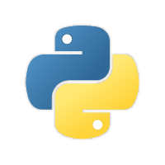









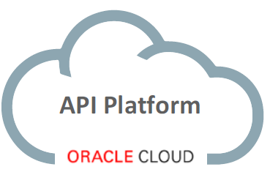




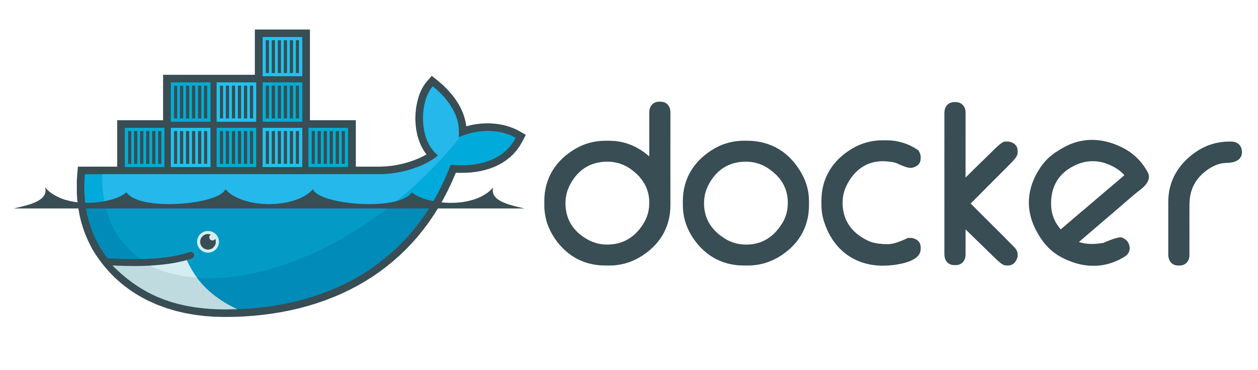

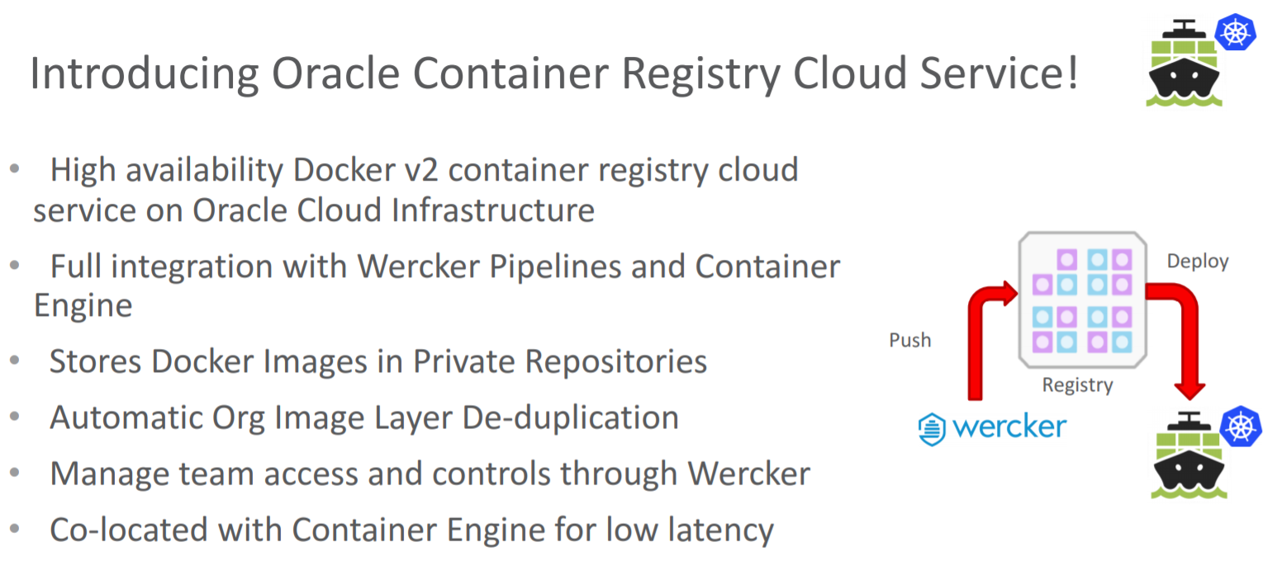



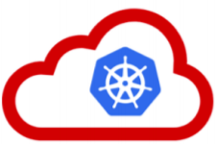




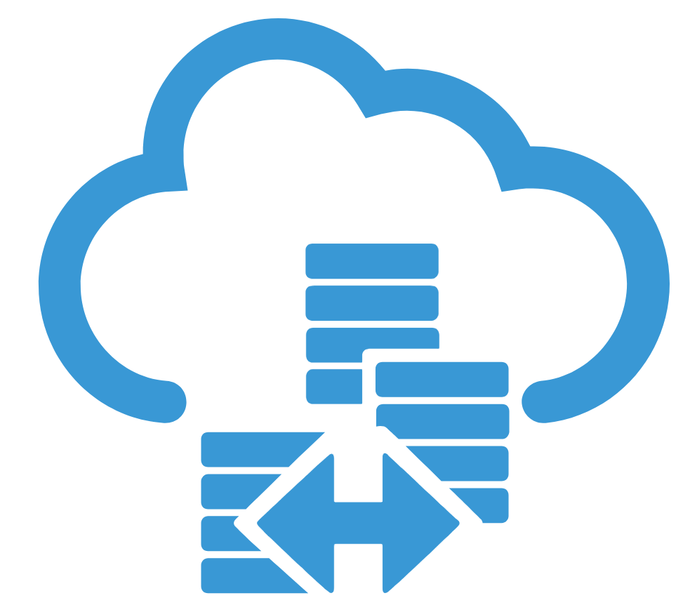
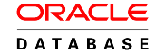



Solution Components
µ
What about?
Visual Builder Cloud
Apiary
API Platform
Event Hub
And 3rd party?
GitHub
Docker Hub
Wercker Container CI/CD
Oracle Container Registry
λ
Application Container
Container Cloud
Container Engine
(Managed K8S)
Container Native Microservices Platform Cloud
Serverless
Fn & Fn Flow
3rd party NoSQL (Elastic Search Index, MongoDB, …)
DBaaS
MySQL
Data Hub
(Cassandra)

Slide 14

Web Shop Portal Solution Design
Meaningful user actions are published from the IFRAME to the parent (the portal) and from the parent to all IFRAMEs – to allow them to respond and synchronize.
For example: CustomerSignIn, ChangedProfileSettings
Note: The IFRAME can receive push notifications (SSE or web socket) from its microservice
Web Shop – Customer User Interface
Client Side (JS) Event Bus & Routing
Context (user settings, navigation history, ..)
Menu & Nav
Marketing content
IFRAME
IFRAME
IFRAME
IFRAME
IFRAME
ViewProduct
InspectInvoice
AddToBasket
Sign Up
Sign In
Edit Profile
µ Customers
µ Orders
µ Products
µ Loyalty
µ Billing, Invoicing & Collection

Slide 15
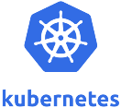




Microservice Implementation
Pod & Service
API Platform & Gateway
Application Runtime
(Application Container)
REST API
UI
Docker Container
REST API
UI
Apiary
(API design & mock)
Event interface
Pub & Sub
Event interface
Pub & Sub
Microservices Platform
Persistence – Relational & NoSQL
Data Lake
Event Bus
Cache
Monitoring & Log Analysis

Slide 16
(upcoming) Oracle Cloud Services
Container Cloud
Wercker
Container Engine (managed Kubernetes)
Managed Fn & Fn Flow (serverless)
Oracle Microservices Platform (to be launched in Feb 2018)
Kubernetes, Istio, Vizceral, Zipkin, Grafana, built-in Fn, Event bus, API management…
API Platform
Data Hub (Cassandra)
Event Hub (Kafka)
Optional/Supporting: IDCS, DBaaS, Application Container, Developer Cloud, Visual Builder Cloud, JET, Management Cloud, “Machine Learning”

Slide 17


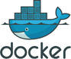


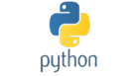

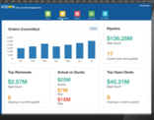


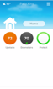





Application Development Patterns Circa 2017
Container Native
Enterprise Java/DB
Serverless
f(x)
Cloud Native PaaS
Visual/Low Code
Notes:
You’ve all seen this and know how to speak to it.
Enterprise Java is meant to represent lift and shift of legacy workloads to the cloud.
Today we’re going to talk about Container Native.

Slide 18
Vision: An End-to-End Container Native Suite
Build, Deploy, Operate – An Open, Standards Based, Cloud Neutral AppDev Platform
Notes:
Oracle’s vision is a complete, open and fully integrated app dev workbench.
Starts with provisioning Oracle Container Engine (managed Kubernetes cluster) and Oracle Registry. You can bring your own registry, but for security and performance (given locality), you can go with Oracle’s.
Composed applications/services mixing microservices and functions.
Commit code in source control to kick-off a build. Run through automated tests. Push to registry. Deploy to your Kubernetes cluster, whether that’s OCE running on OCI or Kubernetes running anywhere else – another cloud provider or on-prem.
Operate with open source tools – mainly following CNCF projects.
Eventually we will provide other managed services.
As a last note, this is a polyglot platform, so you can write apps in Node.js, Go, Python, etc., but being Oracle, we’re offering an optimized Java experience for modern app dev.

Slide 19


Oracle Container Engine and Container Registry
A Managed Kubernetes Service
Oracle Managed
Customer Managed
Container Registry
“Releases”
Container Engine –
Managed Kubernetes
“Clusters”
Customer’s OCI Account/Tenancy
Cluster Management
VM based Clusters and Nodes
HA Masters and etcd
Encryption for Data in Transit (SSL) and at Rest
Bare Metal Clusters and Nodes
K8S Dashboard
Oracle Cloud Infrastructure
Notes:
The grey shaded area designates the functions that Oracle Manages for the customers, including an integrated Registry and image storage (the Releases feature of Pipelines) and the Container Engine / Managed Kubernetes (the Clusters feature of Pipelines).
Oracle will manage the etcd and Master nodes of the Kubernetes instance, in a High Availability setup for the customer. Upgrades to new versions of Kubernetes will also be supported.
The customer will manage the Clusters/Worker Nodes that are setup by the Managed Service for that instance, in their own OCI account/tenancy, shaded in blue above.
Note: The customer will need to bring their own OCI account to use the Clusters feature for Managed Kubernetes and pay for any infrastructure usage incurred with their clusters of worker nodes.

Slide 20




Oracle Container Native Microservices
An open (CNCF and Istio based), cloud neutral, platform makes it easy to develop microservices applications
Pre-integrated, Curated Platform
Open Source, Cloud Native Computing Foundation stack using Istio
Developer Friendly
Opinionated but Open; API first platform
Enterprise Class
Built on Kubernetes with Service Mesh, Service Broker and API Registry; Ops Built In
Service Mesh
REST
API
Service Broker
API Registry
Ops
Pre-Integrated, Curated Plaform CNCF + Istio
Developer Friendly: Opinionated But Open
Enterprise Class: Istio Service Mesh & Infrastructure
Notes:
Step 2: Now you want to build your app.
We provide 2 options:
Microservices
Fn (Functions-as-a-Service or Serverless)
New standards are emerging and evolving from originator projects like Netflix OSS.
Industry has shifted to CNCF projects like Linkerd and Istio.
We have focused on Istio. Linderd offers support for Istio.

Slide 21

Oracle Container Native Microservices Architecture
Foo1
Foo2
API Registry
Event Management
Open Service Broker
Managed Kubernetes
Notes:
Our platform, deployed on top of Kubernetes anywhere, will include:
An Istio based service mesh. Functions as stated.
Kafka based event management.
A service catalog (or broker) that lets you tie in your microservices to external services – could be on other clouds.
Apiary for API management and registry.
Not displayed here, but you can also talk about our use of CNCF ecosystem projects for Operations:
Prometheus - monitoring and alerting toolkit originally built at SoundCloud
Zipkin - a distributed tracing system. It helps gather timing data needed to troubleshoot latency problems in microservice architectures. It manages both the collection and lookup of this data. Zipkin’s design is based on the Google Dapper paper.
Vizceral - a component for displaying traffic data on a webgl canvas. If a graph of nodes and edges with data about traffic volume is provided, it will render a traffic graph animating the connection volume between nodes.

Slide 22
Oracle Container Native Serverless - Functions as Service
a functions (triggered events) based platform
Local Develop
Function
CI/CD
Polyglot function platform with Java Optimizations
Open Source
Container Native with Local Dev Experience
Cloud and Scheduler Neutral
Fn Flow
Polyglot Function Engine
fn
fn
fn
fn
Managed Kubernetes
Notes:
Functions-as-a-Service or Serverless is a rapidly growing movement where there is less concern with underlying infrastructure and more focus on writing code.
Having code kicked off within an event based service.
People think mostly of Lambda. Azure and Google Functions are also there. All very proprietary to cloud provider.
Strategy: open source and community based.
Acquihired Iron.io which was first company to build a cloud neutral serverless solution. Provides credibility.
Cloud neutral. Will run on Kub anywhere. No proprietary lock-in.
Can do local development in Docker. Debug on desktop. Becomes serverless when deploy to a cloud service.

Slide 23
Archived Slides

Slide 24
The Shop
Shop
Product Catalog
Order
Customers
Loyalty Program
Pricing & Discounts
Billing
Logistics (Warehouse, Stock, Shipping)
Invoicing & Collection

